Slide 1

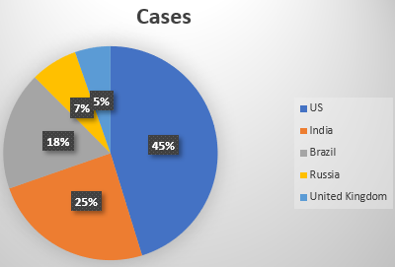




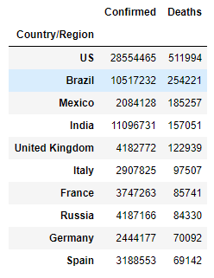




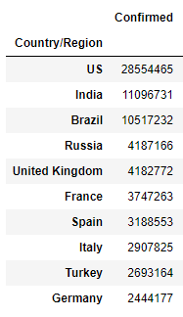
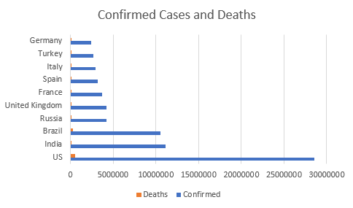
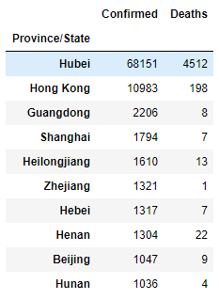
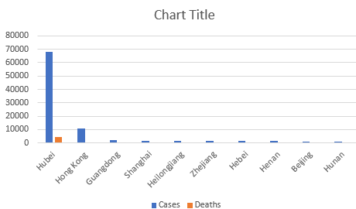

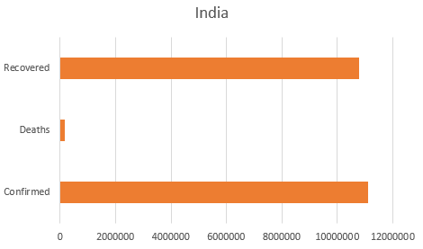
Introduction
2. From this python code I calculated the cases on Christmas day for the top 5 countries and then used that data to create a pie chart to compare how differently each country did, we can see that certain countries had higher rates during Christmas times. For starters this does showcase Christmas wasn’t a big factor in all countries since countries such as India are less likely to have people that celebrate it. As well as that overall the positions of each country do not differ overall from the confirmed cases overall showing that either less cases were reported or that even during holidays rules were being followed.
The data set that I have chosen to analyse covers data for covid-19 starting from 2019 to 2021 (at the time the data was taken). The data that is covered in this data set includes information on countries, continents, cases, deaths, recovered, tests and population. The reason I chose this was to cover a wide area of covid numbers over the world. I will use python to analyse this data set.
The data set:
219 records (Rows)
12 attributes (Columns)
What I aim to cover:
See which 10 countries has the highest cases and then compare how each country has done.
See how the dates of infection during holidays such as Christmas in the top 5 country compare and see whether seasonal holidays have made any difference.
Compare the number of confirmed cases to the amount of people that are infected or sadly dead.
See which country has the highest recovery rate and then compare it to the countries that have the highest confirmed cases.
See how the origin point of the virus (China) is doing in terms of cases and deaths.
3. Here I calculated the amount of deaths using the same approach for confirmed cases and created a horizontal bar chart to see how deaths and cases compare, we can see when comparing the amount of people who have passed away to the confirmed cases and it shows us that deaths and confirmed cases are quite far apart, this means restrictions placed in many countries have been working, however when comparing the numbers for a country such as the UK we can see deaths are quite high since they are only 30,000 behind India which has over double the amount of confirmed cases showing that some countries aren’t managing as well as they could be.
5. Using the python code I have calculated how each, province/state had been doing with the virus and used those results to create a bar chart. Here we can see that at its origin point the virus was dealt with in an appropriate manner as the number of cases and deaths are much smaller than the top 10 countries and this shows although China may have had the virus first it does not mean the origin point will be the most affected point and it is clearly possible to properly contain the virus itself. It also shows how China had a quick response to the virus itself when having to fight against it early on.
1. Starting with my python code I had calculated which countries had the top ten confirmed cases, we can see that the top 4 countries are all similar in the fact they are large countries showing how the virus spreads in more populated areas. At the bottom we see Germany, this also indicates how these top ten countries have been with testing since Germany was one of the first countries to introduce mass testing. Overall we can see the US is at the top this may be well due to many factors such as riots, less covid restrictions that were happening throughout the pandemic showing a clear case rise with more people going out unprotected and not following rules. It also shows a clear trend with countries such as the UK which are smaller than France, Spain, Italy etc. However since the UK also had a bad system for containing the virus even with the smaller population we have staggering amount of more cases.
4. As shown with the python code used to get the results for recovery and combined them with the earlier results for cases and deaths to create a bar chart for how India has done when dealing with the virus since they have the highest recovery rate, here we can see that India has a very high recovery rate with only a few deaths in comparison and the confirmed cases not being that far ahead of recovered. Comparing this to a country like the US we can see bigger countries could be doing better recovery wise since although the US has confirmed cases that are over double of India’s they also have a death rate which is over 3 times than that of India's meaning the proportionate rate is quite high. What this also shows is that covid does not entirely depend on whether a country is more developed or not especially considering India has high risk inhabitants (BAME) meaning there is a clear difference in how countries handled the virus.
References: pandas (2021) Different functions used in python code [online] available from <https://pandas.pydata.org/docs/> - [27 March 2020]
Kaggle (2021) Covid 19 dataset [online] available from <https://www.kaggle.com/sudalairajkumar/novel-corona-virus-2019-dataset> - [27 March 2020]
Thelancet (2021) Used to understand how china dealt with the virus [online available from <https://www.thelancet.com/journals/laninf/article/PIIS1473-3099(20)30800-8/fulltext> - [28 March 2020]

